Slide 1
Reassembling Fractured Objects by Geometric Matching
基于几何匹配的断裂物体重组

Slide 2
Abstract 摘要
We present a system for automatic reassembly of broken 3D solids. Given as input 3D digital models of the broken fragments, we analyze the geometry of the fracture surfaces to find a globally consistent reconstruction of the original object
我们提出了一种自动重新组装破碎的3D实体的系统。输入破碎碎片的3D数字
模型，我们分析了断裂表面的几何形状以找到原始对象的全局一致重建。
Our reconstruction pipeline consists of a graph-cuts based segmentation algorithm for identifying potential fracture surfaces, feature-based robust global registration for pairwise matching of fragments, and simultaneous constrained local registration of multiple fragments
我们的重建管道包括一个基于图割的分割算法，1.它被用于识别潜在的断裂面，
2.碎片成对匹配的基于特征的鲁棒全局配准，3.和同时约束多个片段的局部配准

Slide 3
We develop several new techniques in the area of geometry processing, including the novel integral invariants for computing multi-scale surface characteristics, registration based on forward search techniques and surface consistency, and a non-penetrating iterated closest point algorithm. We illustrate the performance of our algorithms on a number of real-world examples
我们在几何处理领域开发了多种新技术，其中包括用于计算多尺度表面特征的新颖积分不变量，基于前向搜索技术和表面一致性的配准以及非穿透迭代最近点算法。我们在许多实际示例中说明了我们算法的性能

Slide 4
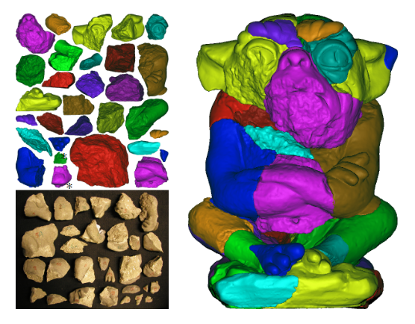
The problem of automatic 3D reconstruction
Given
3D digital models of the solid fragments obtained by 3D laser scanning of the fragment boundary surfaces
通过碎片边界表面的3D激光扫描获得的固体碎片的3D数字模型
Goal
automatically reassembling fractured 3D objects from digital models of their fragments.
自动从碎片的数字模型中重新组合破碎的3D对象。

Slide 5
Algorithm Overview
The input: a set of point cloud surfaces representing the pieces of the fractured object.
我们算法的输入是一组点云表面，它们代表了破碎对象的碎片
1.
automatically segments the fragments into a set of faces bounded by sharp curves (Sec. 3).
自动将碎片分割成一组以尖锐曲线为边界的面(第3节)
(By examining the roughness of the face surfaces, we additionally classify the faces into original faces, which come from the boundary surface of the unbroken object, and fracture faces, which were created when the object broke.
通过检测表面粗糙度，我们还将表面分为原始面(来自未破碎物体的边界表面)和破碎面(物体破裂时产生的表面)
Sharpness
锐度
)

Slide 6
Algorithm Overview
2. compute a novel type of patch-based surface features called feature clusters for all fracture faces(Sec. 4)
计算了一种新的基于patch的曲面特征，称为所有裂缝面的特征聚类(第4节)
3. use these features to match all fracture faces pair-wise (Sec. 5).
使用这些特征来成对匹配所有裂缝面(第5节)
4. The multi-piece matching
多片匹配

Slide 7
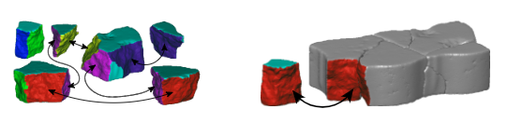
Figure 4: The sixth piece has a better chance to be matched after the first five have been matched and simultaneously registered
图4:在前5个匹配并同时注册之后，第6个有更好的匹配机会

Slide 8
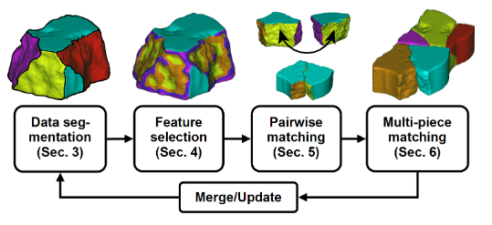

Slide 9
Integral Invariants

Slide 10

Surface integral invariants
Definition
For a point p∈Φ, we define the volume descriptor V^{r}(p) the volume distance descriptor VD^{r}(p) with respect to the kernel radius as

Slide 11

Integral Invariants
V^{r}(p) is related to the mean curvature H, and VD^{r}(p) to the difference of the principal curvatures κ1,κ2 at p
V^{r}（p）与平均曲率H相关，而VD^{r}（p）与点p的主曲率κ1，κ2的差有关

Slide 12
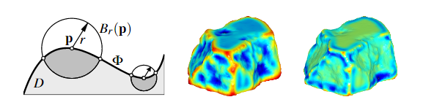
Integral Invariants
Figure 5: (Left) Intersection of the kernel balls B_{r}(p) with the domain D bounded by the surface Φ. (Middle) Volume descriptor, and (right) volume distance descriptor, both shown for one scale
图5：核球Br（p）与区域D被曲面Φ包围的（左）交点。（中）体积描述符和（右）体积距离描述符，均以一个比例显示

Slide 13

Spatial curve integral invariants.
Definition
Let c⊂R₃ be a spatial curve, such as an edge of a fragment. We define the deviation descriptor D^{r}(p) at a curve point p∈c with respect to the kernel radius as

Slide 14

In general, as r→0,D^{r}(p) is related to the curvature κ of c at p,

Slide 15
Multi-scale Surface Characteristics

Slide 16

Surface sharpness.
Definition
We set r_{i}=r_{min}+i·(r_{max}−r_{min})/(N−1) for user specified r_{min} and r_{max} at N, typically 6 to 8, equidistant scales
对于N，我们为用户指定的r_{min}和r_{max，}设置r_{i} = r_{min} + i·（r_{max}-r_{min}）/（N-1）（通常为6到8，等距刻度）

Slide 17

Surface roughness
Definition
we integrate the above bending energy over the local neighborhood N_{r}(p)=Br(p)∩Φ in

Slide 18

Surface roughness
Definition of the local bending energy e_{k}(p) at p
we write |P| for the number of points of a subset P⊂Φ. Let q_{i} be the k-nearest neighbors of a point p∈Φ, and let n_{p} and n_{qi} be the surface normal vectors at these points.
我们写| P |表示子集P⊂Φ的数量。设q_{i}是点p∈Φ的k-最近邻点，设点n_{p ，} n_{qi}表面法线向量

Slide 19
Multi-scale Edge Extraction
we use a modified version of the method presented by [Pauly et al. 2003].
two modifications：
1.In the classification step we replace their ‘surface variation’ by our surface integral invariants and surface
This means essentially that we classify points p as edge points if they have persistent high curvatures at multiple scales as measured by the integral invariants V^{r}(p) and VD^{r}(p) of Equ. (1), and high variance of ρ in the neighborhood of p.
在分类步骤中，我们用表面积分不变量和表面粗糙度度量来代替它们的表面变化。

Slide 20
2. After constructing the minimum spanning graph of the edge points, we specifically extract the long closed cycles from the graph
在构造了边点的最小生成图之后，我们具体地从图中提取了长的闭合环

Slide 21
Final Segmentation
We now refine this segmentation to produce a meaningful set of faces for matching。We begin with the definition of a weighted graph G(F,E). The set of nodes F of the graph G are the faces Fi.
现在我们对这个分割进行细化，生成一组用于匹配的有意义的面集合，如图6所示。我们从一个加权图(F,E)的定义开始。图G的节点集F是面集Fi。
The set E of edges is given by those pairs of faces Fi and Fj with a common border edge. We assign to each edge in E two weights, namely the surface roughness weight w_{r} and the surface sharpness weight w_{s},
边集是由具有共同边界边的面fi和fj对给出的。我们为每一个节点分配了两个权值，即表面粗糙度权值w_{r}和表面锐度权值w_{s}

Slide 22

Here we denote by ρ(S) the mean surface roughness of all points contained in the set S. These weights have the following meaning: wr is the difference between the mean surface roughness of adjacent faces Fi and Fj(and thus will be high between original and fracture faces), and ws is the mean surface sharpness of all points that are shared by faces Fi and Fj(and thus will be high for a sharp edge between two faces).
在这里，我们用ρ（S）表示集合S中包含的所有点的平均表面粗糙度这些权重的含义如下：wr是相邻平面Fi和Fj的平均表面粗糙度之间的差异（因此原始和断裂面之间的差较大），以及ws是由平面Fi和Fj共享的所有点的平均表面清晰度（因此对于在两张面之间有锋利的边缘将较高）

Slide 23
Two series of cuts
1.使用表面粗糙度权重wr
Now we iteratively apply the normalized cut method of [Shi and Malik 2000] to the weighted graph G(F,E)
现在，我们将[Shi and Malik 2000]的归一化切割方法迭代地应用于加权图G（F，E）
We use the surface roughness weight wr and terminate the partitioning of the graph G(F,E) if the surface roughness variance σ 2ρ(Pk) is less than 0.3 for each part P1,P2.
使用表面粗糙度权重wr，如果表面粗糙度方差σ2ρ（Pk）在P1，P2都小于0.3，则终止图形G（F，E）的划分

Slide 24


Slide 25
2. Using the surface sharpness weight ws as a criterion
Using the graph cut method we can merge those faces that are likely to belong to one larger fracture face.
使用图割方法，我们可以合并那些可能属于一个较大断裂面的面
We obtained the final segmentation once the graph-cut threshold ws falls below 0.1
当图割阈值w下降到0.1以下时，我们获得了最终的分割

Slide 26
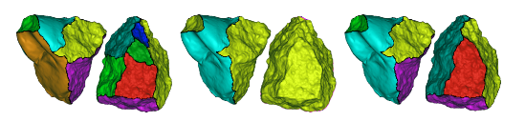
Figure 6: Data segmentation of two fragments. (Left) Initial segmentation. (Middle) Segmentation into original and fracture surfaces. (Right) Final segmentation of fracture surfaces.
图6：两个碎片的数据分分割。（左）初始分割。（中）分割成原始和断裂表面。（右）断裂面的最终分割

Slide 27
4.Feature Selection and Representation

Slide 28
Feature Selection
Suppose we have a series of descriptors {g1,...,gn}, which are functions defined on a surface Φ(e.g. a set of integral invariants as defined in Sec. 2.1). We use the level sets of these functions to partition Φ into surface patches. These patches and combinations of them are used as features (also called feature clusters hence forth).We first introduce feature selection using a single descriptor g, and then we proceed with multiple descriptor based feature selection
假设我们有一系列的描述符{g1，...，gn}，它们是在一个面Φ上定义的函数（例如，第2.1节中定义的一组积分不变量）。我们使用这些函数的水平集将Φ划分为表面patch。这些patch及其组合被用作特征（也称为此后也称为特征簇）。我们首先使用单个描述符g介绍特征选择，然后再进行基于多个描述符的特征选择。

Slide 29
Feature selection using single descriptor
Feature selection using single descriptor. Given a descriptor g whose range is I_{g}=[0,b], we partitioning into equally sized intervals[l_{i},l_{i+1}], usually 32 in number. For each pair of levels l_{i}<l_{j}, we denote the set of surface points p whose descriptor values g(p) fall into the interval[li,lj] by S_{ij} .Starting from an arbitrary point of S_{ij} and using depth-first search on the K-nearest neighbors, we cluster the points of S_{ij} into C^{k}_{ij} (this clustering is analogous to extracting connected components, but performed in a point cloud setting). Then we remove those clusters C^{k}_{ij} where either min_{p}g(p)>l_{i+1}or max_{p}g(p)<l_{j−1} holds for a p∈C^{k}_{ij} because they are redundant.

Slide 30
Feature selection using single descriptor
给定一个描述符g，其范围为I_{g} = [0，b]，我们将I_{g}划分为大小相等的间隔[l_{i}，l_{i + 1}]，通常为32个。对于每对水平l_{i} <l_{j}，我们记S_{ij}表示描述符值g（p）落入间隔[l_{i}，l_{j}]（见图7）中的点集合。从S_{ij}的任意一点开始，使用K近邻的深度优先搜索，将S_{ij}中的点聚合进C^{k}_{ij}（此聚类类似于提取连接的分量，但在点云中执行）。然后我们删除min_{p}g(p)>l_{i+1}或max_{p}g(p)<l_{j−1}那些簇C^{k}_{ij}，p∈C^{k}_{i}成立，因为它们是多余的。

Slide 31
Feature selection using multiple descriptors
We first order the descriptorsg1,...,gn according to their associated scales (kernel radii)r_{i}, i.e.,g_{i}>g_{i+1} if r_{i}>r_{i+1}. Later in the matching algorithm, we will use feature correspondences produced by descriptors of small scales to verify feature correspondences produced by descriptors of large scales. We select features using the single descriptor algorithm described above for each gi. We designate as C_{gi} a cluster produced by the single descriptor feature selection algorithm for descriptor gi
我们首先根据描述符的关联标度r_{i}，即g_{i}>g_{i+1} 若 r_{i}>r_{i+1}对描述符g1，... gn进行排序。稍后在匹配算法中，我们将使用由小规模描述者生成的特征对应关系来验证由大尺度描述符号生成的特征对应关系。我们使用上述针对每种方法的单个描述符算法选择功能。我们指定由单个描述符gi特征选择算法产生的簇为C_{gi}

Slide 32
Feature selection using multiple descriptors
The above process is repeated for computing feature clusters from points that belong to the boundaries between the fragment faces, as computed by the segmentation algorithm in Sec. 3. Therefore, the feature selection algorithm produces a set of fracture surface features and a set of fracture edge features. The descriptors we use are based on the integral invariants introduced in Sec. 2.1. For selecting fracture surface features we use two volume descriptors g1=V^{rmax}, g3=V^{rmin} , and two volume distance descriptors g2=VD^{rmax}, and g4=VD^{rmin(}see Equ. (1)), and we discard descriptors near the sur-face boundary. For fracture edge features we use deviation descriptors g1=D^{rmax} and g2=D^{rmin} (see Equ. (2)). The use of different scales makes the descriptors robust to noise.

Slide 33
Feature selection using multiple descriptors
重复上述过程，从碎片面之间的边界点计算特征聚类，如第3节的分割算法所计算。因此，该特征选择算法产生了一组断裂面特征和一组断裂边特征。我们使用的描述符基于第2.1节中介绍的积分不变量。为了选择断裂面特征，我们使用了两个体积描述符g1=V^{rmax}, g3=V^{rmin,}，以及两个体积距离描述符g2=VD^{rmax}, and g4=VD^{rmin}，并且我们丢弃了靠近表面边界的描述符。对于碎片边缘特征，我们使用偏差描述符g1=D^{rmax} 和 g2=D^{rmin}（请参阅等式（2））。不同尺度的使用使得描述符对噪声具有鲁棒性。

Slide 34
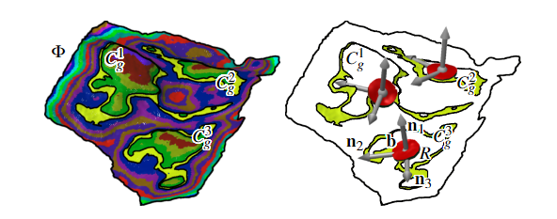
Feature selection using multiple descriptors
Figure 7: Feature selection and representation. (Left) Color codedsetsSi,i+1for a single descriptor g on a fracture surface Φ. (Right)Three feature clusters C kg,k=1,2,3 and the representation via barycenter b, vectors nj, and set R(disc like), see Equ. (7)
图7：特征选择和表示。（左）针对单个描述符边的断裂面Φ的颜色编码集S_{i，i + 1} （右）三个特征簇C^{k}_{g}，k = 1,2,3，其表示形式为质心b，向量n_{j}和集合R（类似圆盘），请参见等式7

Slide 35
Feature cluster topology.
The above feature selection process produces a large number of overlapping feature clusters. In order to efficiently process feature correspondences in the matching stage of our algorithm, we will define a topology on the feature clusters.
上面的特征选择过程产生了大量重叠的特征集群。为了在匹配阶段高效处理特征对应, 我们将在特征簇上定义拓扑。
We call two clusters C and D neighbors if they have any points in common. Notice that C and D can be clusters that correspond to the same descriptor, or two different descriptors.
如果两个簇有任何共同点，我们将其称为C和D邻居。注意，C和D可以是与相同描述符或两个不同描述符相对应的簇。
In the case of feature clusters corresponding to two different descriptors, gi and gj, we additionally call C_{gj} a parent of C_{gi} if the kernel radius r_{j}>r_{i}.
对于对应于两个不同描述符gi和gj的特征簇，如果内核半径rj> ri，则另外用C_{gj}是C_{gi}的父母。

Slide 36
Feature Representation
In order to use the selected feature clusters for matching fragment faces, we derive a concise representation of each cluster using a set of characteristic values, vectors, and points. We perform principal component analysis (PCA) on all points in each feature cluster C. The principal components and corresponding principal directions are denoted by λ1<λ2<λ3 and n1,n2,n3, respectively. Moreover, the nj are put in a right-handed coordinate system.
为了将选定的特征簇用于匹配碎片面，我们使用一组特征值，向量和点来得出每个簇的简洁表示。
我们对每个特征簇C中的所有点进行主成分分析（PCA），主成分和相应的主方向分别由λ1<λ2<λ3和n1，n2，n3表示。而且，nj被放入了右手坐标系

Slide 37
Representation of fracture surface features
We store the following information for each cluster C

Slide 38
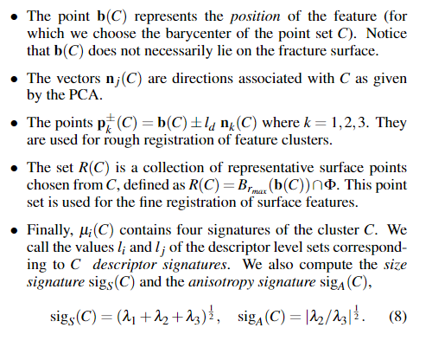
b（C）表示要素的位置（为此我们选择点set C的重心）
向量n_{j}(C)是与PCA给出的与C相关的方向
它们用于特征簇的粗略注册
这个点集用于表面特征的精细注册
我们可以将描述符级别集的值与c描述符签名相对应

Slide 39
Representation of fracture edge features.
重心，集合R（C），描述符签名和尺寸size签名的计算与表面情况类似。
边缘特征C的各向异性特征被定义为
边缘特征的方向向量n_{j}定义如下。
通过在C上执行PCA，我们得到n₁作为沿裂缝边缘指向的主要方向。
n₂被指定为对应于最小特征值的R（C）的主要方向。
仅针对k = 1,2计算点p±_{k}（C）。
如果边特征C属于断裂表面和原始表面的断裂曲线，我们签名sig_{a}（C）=∠（n₁，n_{o}），其中n_{o}是C中原始表面点的平均表面法线还为其指定角度

Slide 40
Pairwise Matching

Slide 41
We use the features introduced in the preceding section to match the fragments pairwise. Let S and T be two faces on two fragments, produced by the segmentation algorithm.
我们使用上一节介绍的特征来成对匹配片段。 令S和T是由分割算法产生的两个片段上的两个面。
We seek to find the set of common features on S and T and find an aligning transformation that brings S close to T .
我们力求在S和T上找到一组共同的特征，并找到使S接近T的对齐变换。
The initial correspondence set is refined by several novel pruning algorithms and the final set of matching features is found robustly using a forward search algorithm.
通过几种新的剪枝算法对初始匹配集进行改进，利用前向搜索算法鲁棒地找到匹配特征的最终集

Slide 42
Similar to [Gelfand et al. 2005] we keep all consistent sets of matching features, instead of choosing just one best match. We then use multi-piece matching described in Sec. 6 to select the best match between a pair of faces in the global context
我们保持所有匹配特性的一致性，而不是只选择一个最佳匹配。然后，我们使用第6节中描述的多片匹配来选择最佳匹配

Slide 43
Let S and T be two faces on two fragments, produced by the segmentation algorithm
令S和T是由分割算法产生的两个片段上的两个面。
We seek to find the set of common features on S and T and find an aligning transformation that brings S close to T. For each feature on S, we find all corresponding features on T and then extract subsets of consistent feature correspondences.
我们力求在S和T上找到一组共同的特征，并找到使S接近T的对齐变换。对于S上的每个特征，我们在T上找到所有对应的特征，然后提取一致特征对应的子集
Then pruning

Slide 44
Feature Correspondences
We build the initial set of correspondences by finding for each feature cluster C in S all clusters D in Twhich have similar descriptor values.
通过寻找S中的每个特征簇C和T中具有相似描述符值的所有簇D，我们构建了初始的对应集
Two features Cgi and Dgi potentially correspond if they were computed using the same descriptor gi and have the same descriptor signatures (level sets of the descriptor).
如果两个特征Cgi和Dgi是使用相同的描述符gi计算的，并且具有相同的描述符签名（描述符的水平集），则可能会对应。

Slide 45
For edge features, we additionally ensure the match of the angle signature, if it exists. Every edge feature correspondence with angle signatures sig_{a}(C_{gi}) and sig_{a}(D_{gi}) is required to satisfy |sig_{a}(C_{gi})+sig_{a}(D_{gi})|<ε_{θ}.
对于边特征，我们额外地确保角签名的匹配，如果它存在的话。每条边与角特性对应签名sig_{a} (Cgi)和sig_{a} (Dgi)需要满足|sig_{a}(C_{gi})+sig_{a}(D_{gi})|<ε_{θ}.

Slide 46
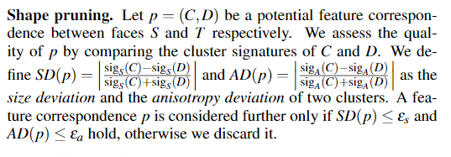
Shape pruning

Slide 47

令p =（C，D）分别是面S和T之间的潜在特征对应。 我们通过比较C和D的聚类签名来评估p的质量
作为两个簇的尺寸偏差和各向异性偏差。 仅当SD（p）≤εs和
AD（p）≤εa成立时，才进一步考虑特征对应关系p，否则我们将其丢弃。

Slide 48
Topological pruning.
We use the topology of the feature clusters to discard redundant and false correspondences and to verify the correct ones. The pruning works in two steps
我们利用特征簇的拓扑结构来剔除冗余和错误的对应，并验证正确的对应
1. we consider feature correspondence pairs that were generated by different descriptors.
我们考虑由不同描述符产生的特征对应对
2.we consider correspondence pairs with overlap-ping clusters corresponding to the same descriptor.
我们考虑与相同描述符相对应的重叠簇的对应对

Slide 49
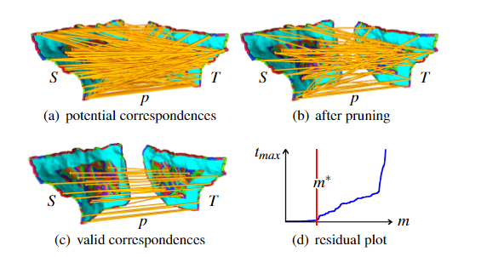
Figure 8: Pairwise matching. The potential feature correspondences {p} between faces S and Tare pruned; valid correspondences are extracted using a forward search. The iteration step m∗,when outliers become included, is clearly seen in the residual plot
成对匹配。修剪面S和T之间的潜在特征对应关系{p}；使用正向搜索提取有效的对应关系。在残差图中可以清楚地看到迭代步骤m *（当包含奇异值时）

Slide 50
Potential Matches
After selecting high quality feature correspondences we face the task of finding possible matches between fracture faces S and T. We regard this problem as a fitting problem, where the data points to be fitted are feature correspondences.
在选择了高质量的特征对应后，我们面临的任务是在断裂面S和T之间寻找可能的匹配。我们将此问题视为拟合问题，拟合的数据点为特征对应
As incorrect feature correspondences can be seen as masked outliers, we use the forward search method, which has successfully been used in defining point set surfaces by [Fleishman et al. 2005].
由于不正确的特征对应可以被看作是被掩蔽的异常值，我们使用了forwardsearch方法，它已经被成功地用于定义点集表面[Fleishman et al. 2005]

Slide 51
Registration consistency.
All geometrically consistent correspondence pairs are further checked using local registration by minimizing the sum of squared distances between certain corresponding points related to p1=(C1,D1)andp2=(C2,D2).
通过最小化与p1 =（C1，D1）和p2 =（C2，D2）相关的某些对应点之间的平方距离的总和，使用局部配准进一步检查所有几何上一致的对应对。

Slide 52
Using the quaternion method proposed by [Horn 1987], we find the optimal Euclidean transformation that maps the points(b(C1),p±k(C1)) of feature C1to their corresponding points(b(D1),p±k(D1))ofD1,and similarly forC2,D2.
利用[Horn 1987]提出的四元数方法，我们找到了将特征C1的点(b(C1)，p±k(C1))映射到特征D的对应点(b(D1)，p±k(D1))的最优欧几里德变换 ，对于特征C2,D2也是如此
The obtained initial position of the features is further improved using local registration as described by[Pottmann et al. 2006] using the whole set of data points contained in the sets R(C)of all four features.
使用[Pottmann等人，2006年]描述的局部配准可进一步改善获得的特征的初始位置。使用所有四个特征的集合R（C）中包含的整个数据点集

Slide 53
Forward search

Slide 54
Global Multi-piece Matching

Slide 55
Based on the results of the pairwise matching
Based on the results of the pairwise matching we define a graph G(F,E), where each node Fi∈F represents a fragment and each edge e=(Fi,Fj)∈E one of (possibly several) matches between two fragments Fi and Fj.
基于成对匹配的结果，我们定义了图G（F，E），其中每个节点Fi∈F代表一个片段，每个边e =（Fi，Fj）∈E（两个片段之间（可能是多个）匹配项之一） Fi和Fj。

Slide 56
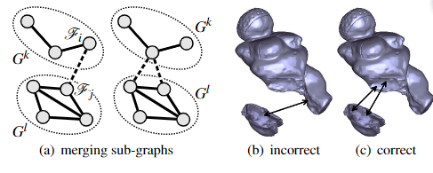
Figure 9: Different strategies for merging two sub-graphs Gk and Gl. (Left) Using the edge of maximum weight that connects these two sub-graphs. (Right) Using the group of consistent edges of maximum weight that connect these two sub-graphs

Slide 57
Multi-piece Local Constrained Registration
After global multi-piece matching of the 3D fragments we move them to their final alignment by simultaneous registration.
在对3D片段进行全局多段匹配之后，我们通过同时注册将它们移至最终对齐。

Slide 58
Fragment merging.
using the bidirectional closest point search method of [Pauly et al. 2005]. In a second step we fill any holes using a modified method of [Amenta and Kil 2004] such that the virtual fragment is a single closed surface
使用[Pauly 2005]等人的双向最近点搜索方法删除所有匹配的断裂面的点。 第二步，我们使用[Amenta and Kil 2004]的改进方法填充所有孔，以使虚拟片段为单个封闭表面

